Slide 1
Employee Data Analysis using Excel
STUDENT NAME : S.SANDHIYA
REGISTER NO : 2213371036238
DEPARTMENT : COMMERCE
COLLEGE : QUIAD-E-MILLATH GOVERNMENT COLLEGE FOR WOMEN(AUTONOMOUS)

Slide 2
PROJECT TITLE
Employee Performance Analysis using Excel

Slide 3


AGENDA
Problem Statement
Project Overview
End Users
Our Solution and Proposition
Dataset Description
Modelling Approach
Results and Discussion
Conclusion
3/21/2024 Annual Review

Slide 4

PROBLEM STATEMENT :Analyzing Employee Performance Metrics to Improve Organizational Efficiency
Our organization has been tracking various performance metrics for employees across different departments. Despite collecting substantial data, we lack a comprehensive understanding of how these metrics correlate with overall job performance and organizational outcomes.
There is a need to analyze this data to identify patterns, trends, and insights that can inform strategies for improving employee performance and efficiency.

Slide 5

PROJECT OVERVIEW
In today’s competitive business environment, understanding and improving employee performance is critical to organizational success. Our current performance evaluation processes are primarily based on subjective assessments, which may not fully capture employee contributions or identify areas for improvement.
To address this, we aim to conduct a comprehensive data analysis to gain deeper insights into employee performance, identify patterns and correlations, and ultimately enhance our performance management practices.

Slide 6

WHO ARE THE END USERS?
1. Human Resources (HR) Department
2. Senior Management and Executives
3. Department Heads and Managers
4. Employees
5. Training and Development Teams
6. Compensation and Benefits Teams
7. Organizational Development Specialists
8. Quality Assurance and Compliance Teams
9. Data Analysts and Business Intelligence (BI) Professionals
10. Board of Directors

Slide 7

OUR SOLUTION AND ITS VALUE PROPOSITION
conditional formatting – to identify the missing data
filter – for the purpose of removing the unwanted data.
formula- for identifying the performancre the employees .
pivot table - to convert the data into short summary .
graph – data visualization

Slide 8
Dataset Description
Information on age, gender, department, role, tenure, education level, and other factors that may influence performance .
Records of employee attendance, including absences, lateness and leave’s.
These data points provide a comprehensive overview of employee performance, enabling organizations to identify strengths, areas for improvement, and opportunities for growth

Slide 9

THE "WOW" IN OUR SOLUTION
PERFORMANCE LEVEL=IF(Z8>=5, "VERY HIGH", IF(Z8>=4, "HIGH", IF(Z8>=3, "MEDIUM", "LOW")))
3/21/2024 Annual Review
9

Slide 10
MODELLING
DATA COLLECTION
Downloaded the employee data performance from EDUNET DASHBOARD
FEATURE COLLECTION
IDENTIFIED EACH FEATURE
DATA CLEANING
Identified the missing values.
Filtered the missing values.
PERFORMANCE LEVEL
SUMMARY
PIVOT TABLE
PIE CHART
VISUALIZATION
GRAPH
10

Slide 11
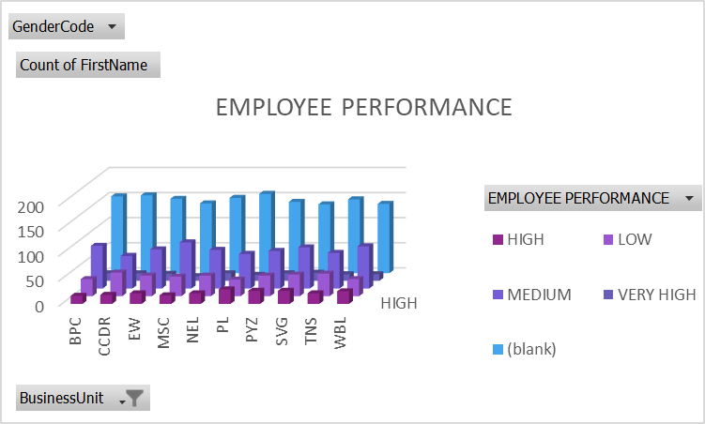
RESULTS
11

Slide 12
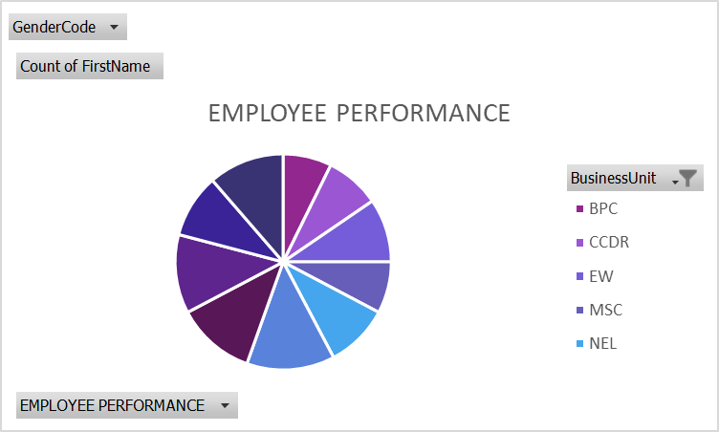
RESULT

Slide 13
conclusion
EMPLOYEE PERFORMANCE ANALYSIS
BY COMPARING THE PERFORMANCE OF THE EMPLOYEES. THE EMPLOYEES ARE HIGHER IN NUMBER. THERE ARE MORE PEOPLE IN AVERAGE LEVEL EMPLOYEES.
WE HAVE TO MOTIVAYE THE EMPLOYEES TO DEVELOP THEIR SKILLS AND TALENTS TO ACHIEVE THE ORGANISATIONAL GOALS AND OBJECTIVES TO REACH THE PLACE OF HIGH LEVEL PERFORMANCE TO SUSTAIN THE GOALS AND TARGETS.
WE HAVE TO TRAIN AND DEVELOP THE EMPLOYEES WITH BETTER OUTCOME TO REACH THE ORGANISATIONAL

